Slide 1
Arduino based robotic object pick arm

Slide 2
Objectives:
-Here in this project, Arduino Uno is programmed to control servo motors which are serving as joints of Robotic arm for picking an object.
-This setup also looks as a Robotic Crane or we can convert it into a Crane by doing some easy tweaks.
-This project will be helpful for beginners who want to learn to develop a Simple Robot in low cost or just want to learn working with Arduino and servo motors.
-This Arduino Robotic Arm is controlled by four Potentiometer attached to it, each potentiometer is used to control each servo. We can move these servos by rotating the pots to pick some object.(Low torque servos)

Slide 3
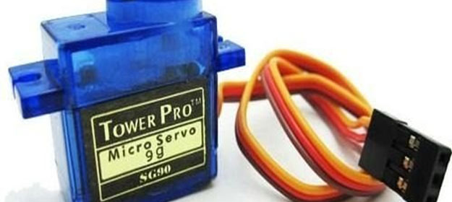
Servo Motor
Servo Motors are mainly used when there is a need for shaft movement or position
- Here four SG90 servos were used

Slide 4
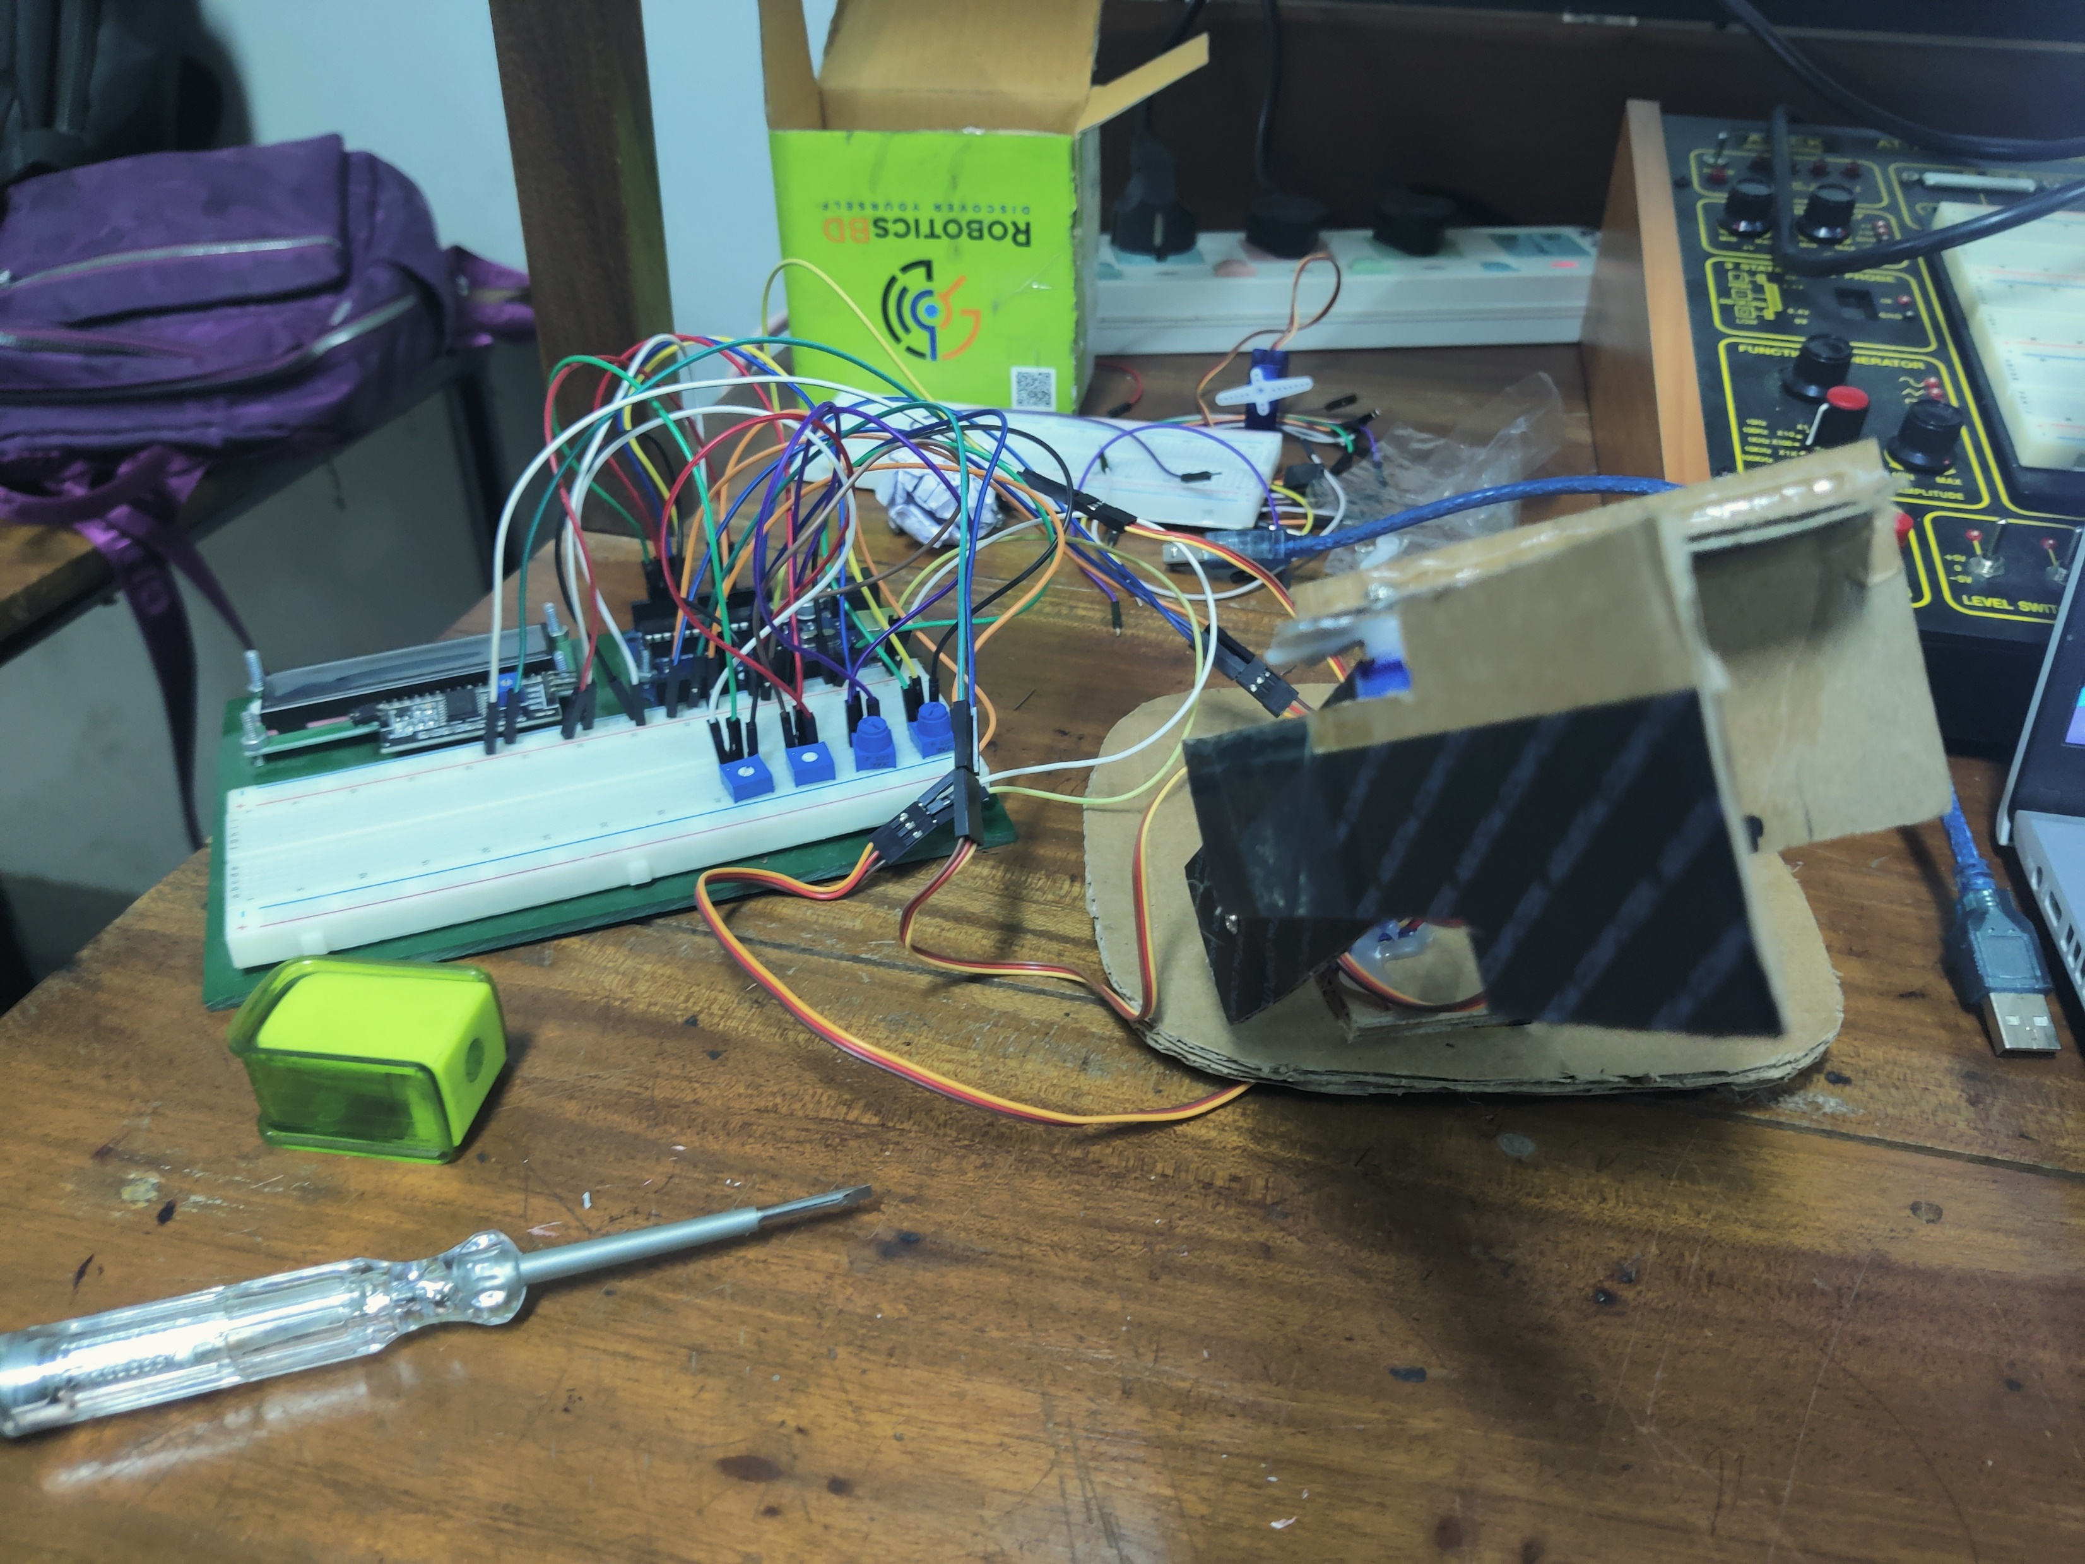
Applied Circuit Design:
As per as the practical circuit construction I have used low torque servo motors and to control individual servo we used individual potentiometer.
-A servo motor basically controls the rotation of a DC motor by controlling a circuit that synthesizes its angle.
-The angle of a servo motor is between 0 degree and 180 degrees .To move the servo, I used Write() function with the required angle of rotation as argument.
-Then pulse width sent to the motors then changes according to angle change and it demarks the extent of rotation.
-By varying potentiometer I moved the cardboard attached with servo motors in between angle and pick my object.

Slide 5
CIRCUIT OPERATION:
Used four potentiometer with 10 k resistance.
Every pot will work on 5 volt which divided into 1023 division.
Each division will carry 5-6 mV.
For 5-6 mV it rotates 1degree.
To control this robotic arm four servo were applied for four parts to move around the robotic arm as my wish.
It can rotate 360 degree.

Slide 6
Functions of Servo Motor:
The first servo is in the base and it controls the robotic arm to rotate 180 degrees.
Second servo was used as the elbow of the robotic arm and it helps to uplift the arm left to right and right.
Third servo is in wrist position and it helps to pick up any object.
The fourth servo is in the gripper position and it helps to grip any object as human fingers.

Slide 7
CIRCUIT SETUP
First I connected the servo motor here first servo is connected to digital pin 6, and the second servo is connected to digital pin 9; the third servo is connected in digital pin 10; the fourth servo is connected in digital pin 11. and other two pin of each servo middle pin is connected in 5 volts and other pin is connected in ground pin. This digital pin can act as an analog pin.
Then I connected the potentiometer to control the servo, here first potentiometer is connected to analog pin A0; the Second potentiometer is connected in analog pin A1; Third potentiometer is connected in analog pin A2; Fourth potentiometer is connect in analog pin A3;and other two pin of each potentiometer middle pin is connected in 5 volts and other pin is connected in ground pin.

Slide 8
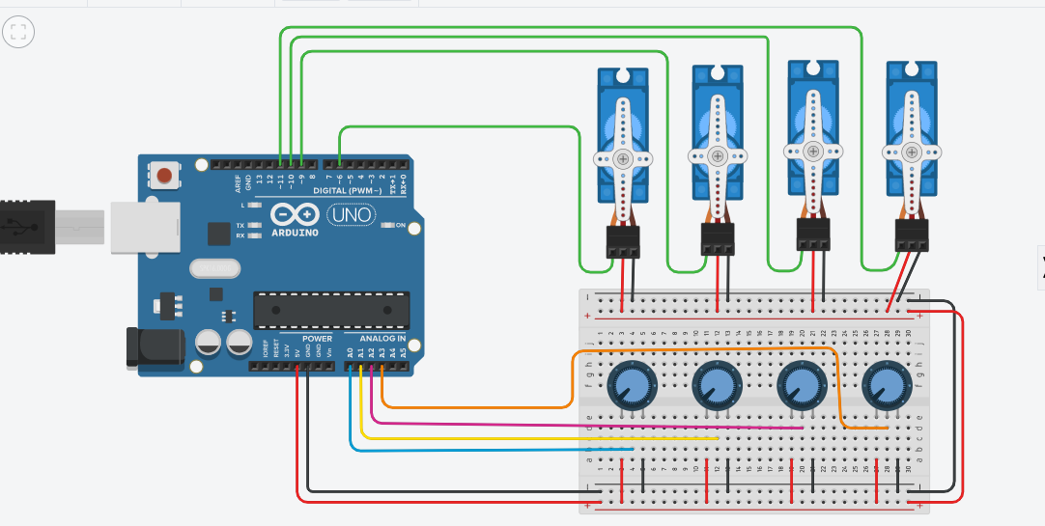
Circuit Diagram

Slide 9
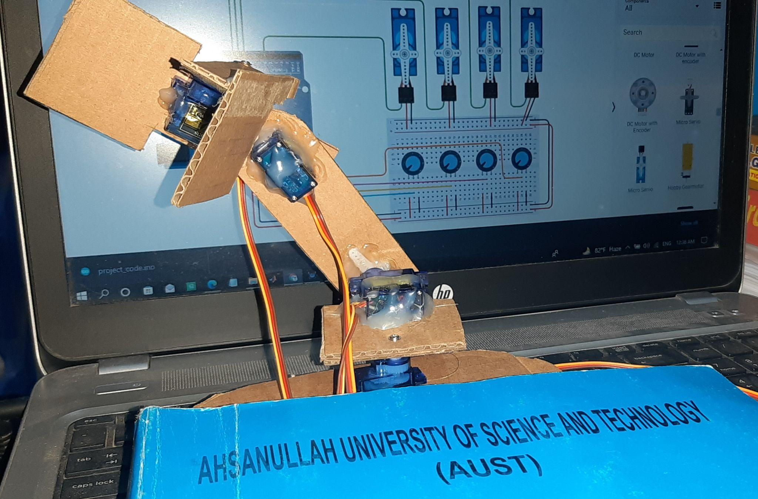
Practical Position of Servo
4th Servo
3rd Servo
2nd Servo
1st Servo

Slide 10
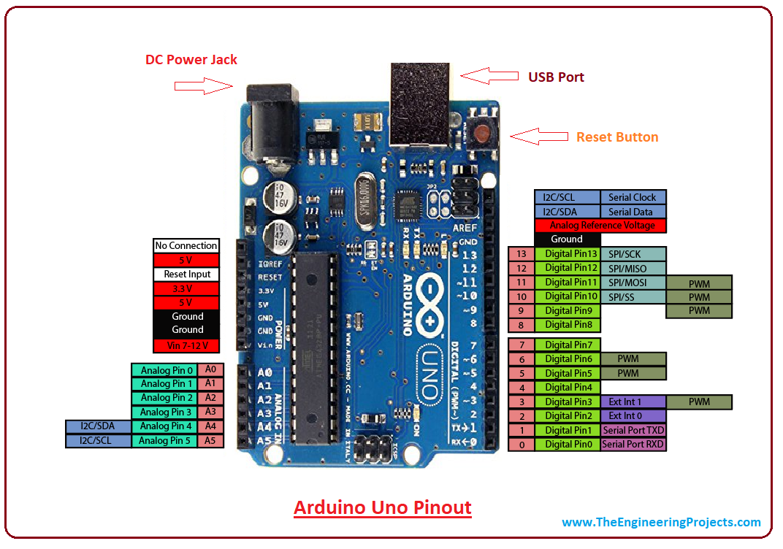
Arduino UNO Board

Slide 11
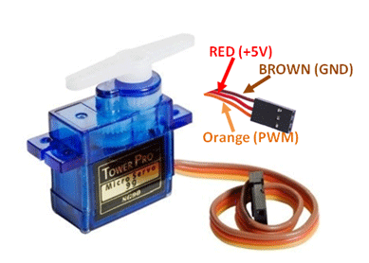
Servo Pin Connection

Slide 12
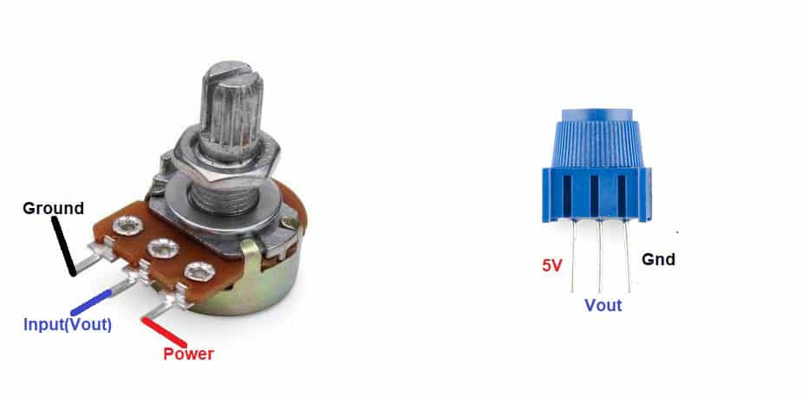
Potentiometer

Slide 13
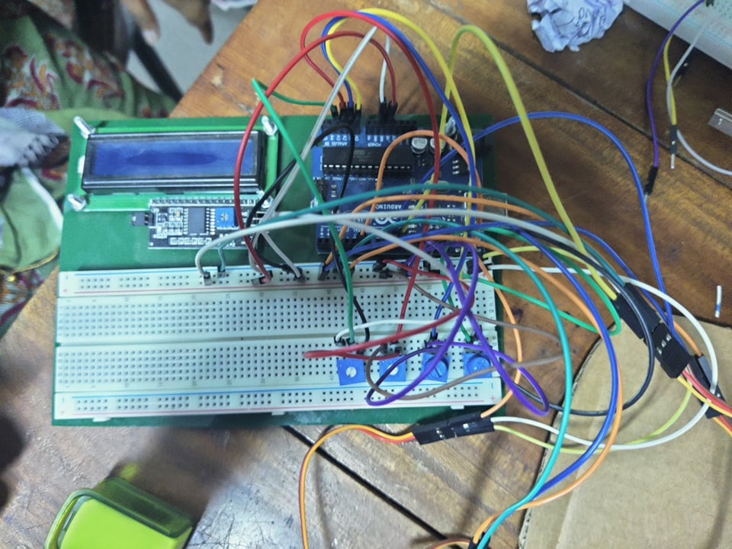
Experimental Breadboard Circuit
POT 1
POT3
POT 2
POT 4

Slide 14
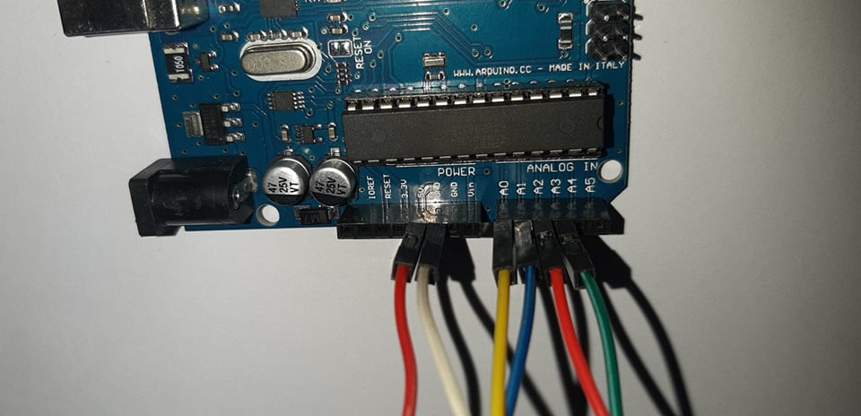

Slide 15
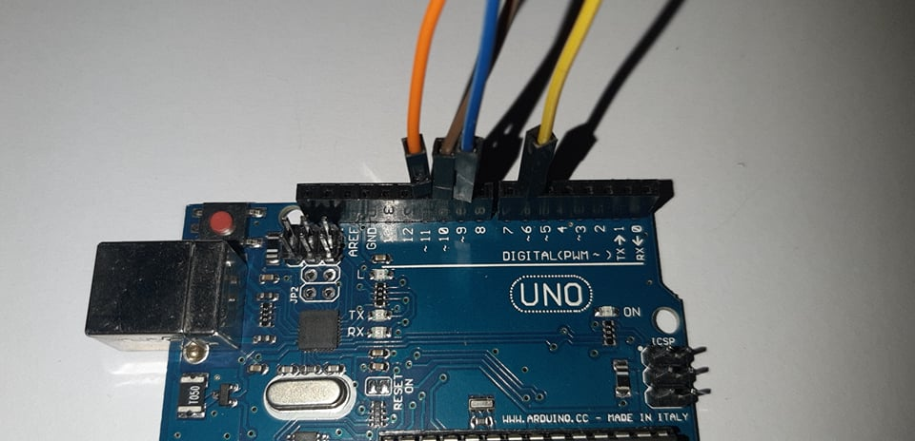

Slide 16

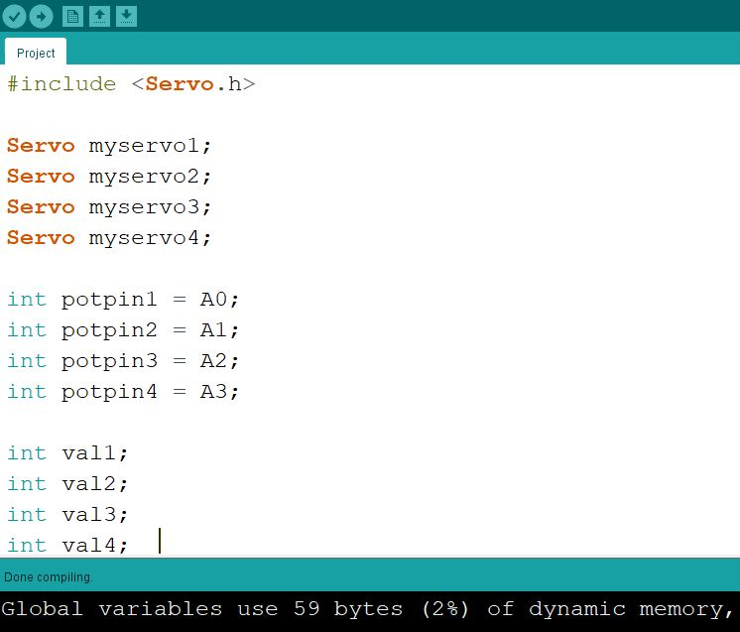
Arduino Code

Slide 17

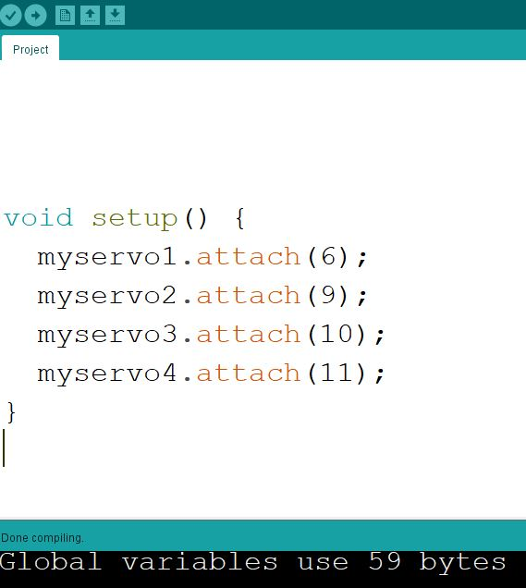
Setup part of the code

Slide 18
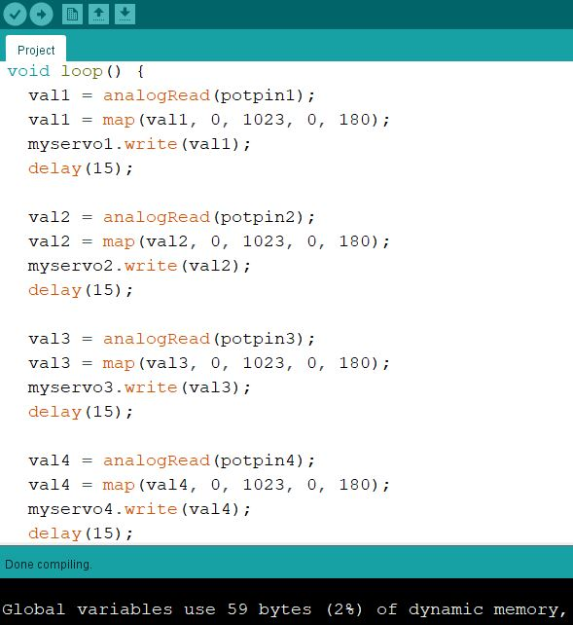
Loop part of the code

Slide 19
